Slide 1
Lecture 0: Python Applications
Shahane Arushanyan
Introduction to Python. Fall 2018

Slide 2

Outline
What can you do with Python?

Slide 3


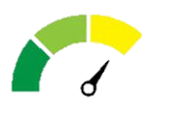
Easy! Useful! Powerful!
The first step into the world of programming
Released in 1991, has become popular in the last couple of years
Easy to read and learn
No programming skills required
Beginner or expert

Slide 4







Popular in big and small companies

Slide 5


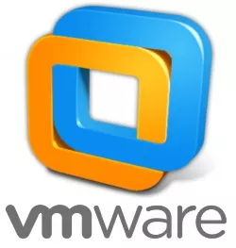


Popular in big and small companies

Slide 6
Some additional features
Open source language
A lot of libraries for basically everything! (What are libraries?)
Used for small, medium and large projects in different spheres

Slide 7
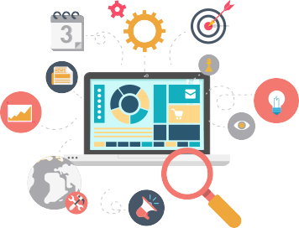
Web Development
Use python to create web applications of different complexities
Python web frameworks include: Pyramid, Django and Flask

Slide 8




Are you surprised?

Slide 9
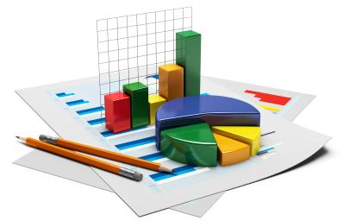
Data Analysis
Leading language of choice of many data scientists
Python libraries like NumPy, Pandas and data visualization libraries Matplotlib and Seaborn.

Slide 10
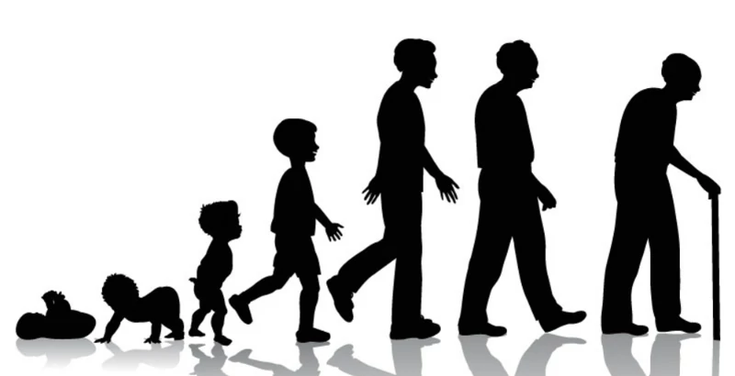
Example: Age of customers
500000 customers -> sample 5000
Simplest -> use a histogram

Slide 11
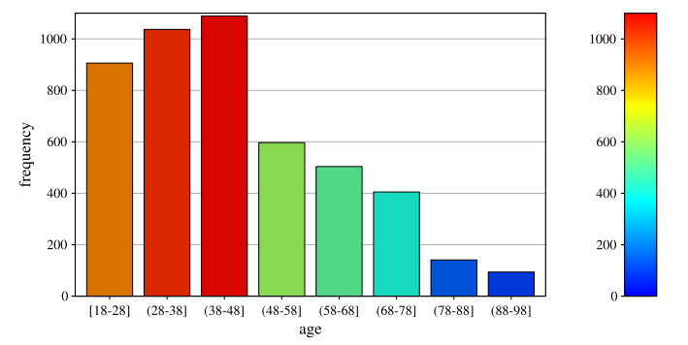
8 bins

Slide 12
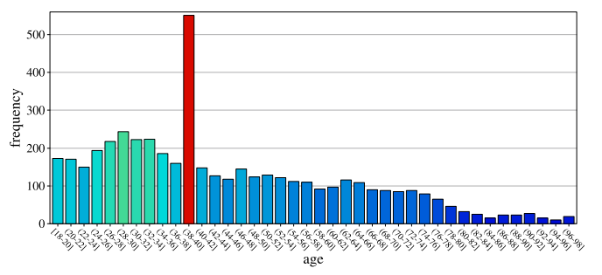
40 bins

Slide 13
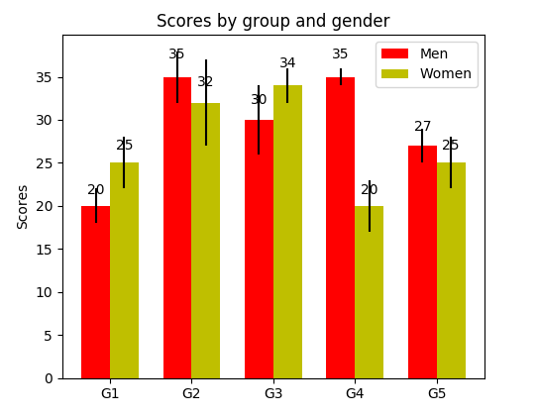

Slide 14
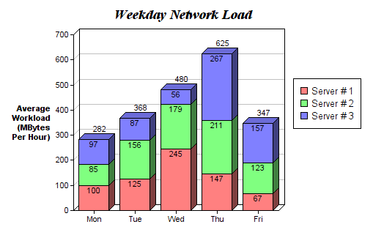

Slide 15



Example: continued
Similarity:
Similar customers
Products that are correlated
Etc.
Customer 2
Customer 1

Slide 16
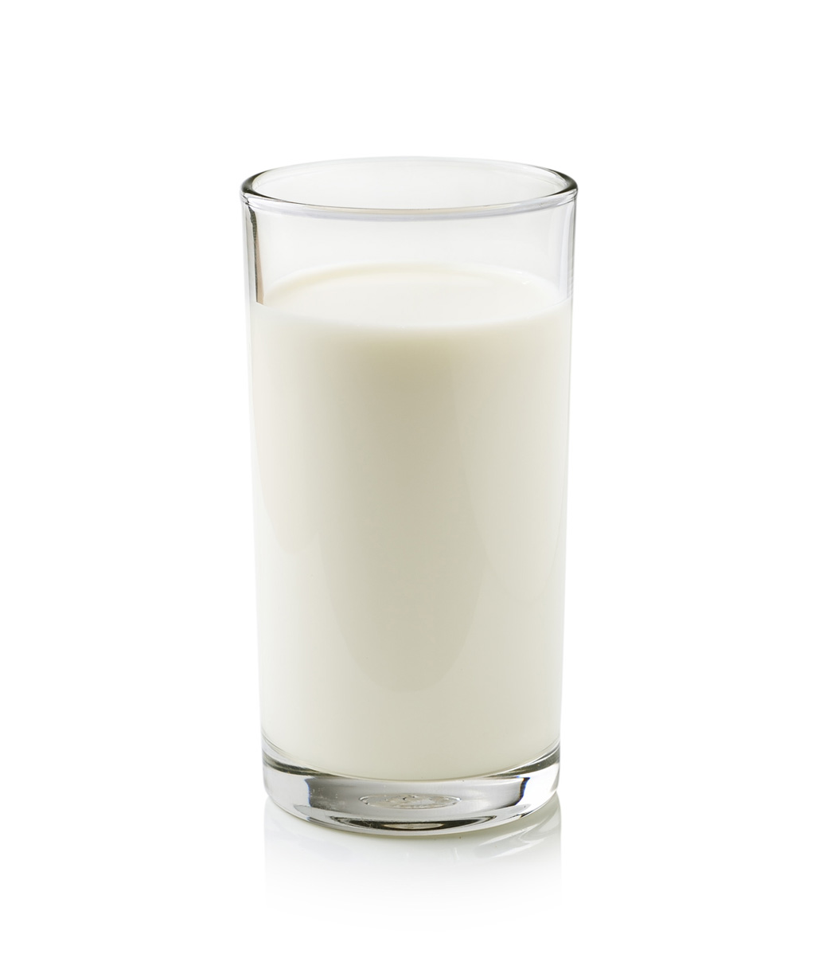
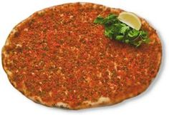
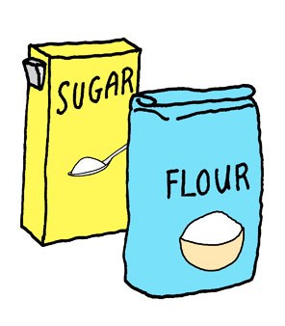

Example: continued
Similarity:
Similar customers
Products that are correlated
Etc.

Slide 17

Machine Learning - the science of getting computers to learn and act like humans do, and improve their learning over time
Predict customer satisfaction
What factors will affect the demand of the product?
Machine learning libraries include Scikit-Learn, NLTK and TensorFlow.

Slide 18
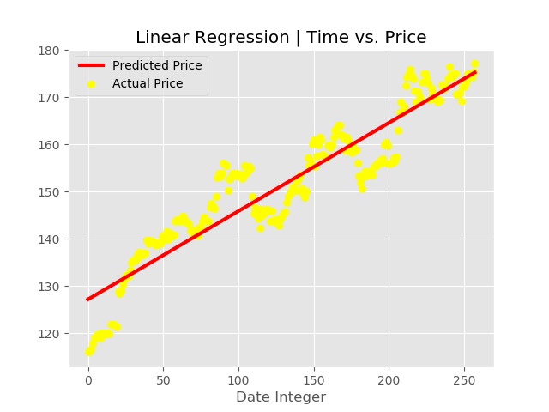

Slide 19
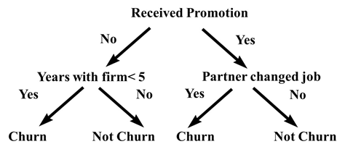
Example: Employee churn analysis

Slide 20

Example: Churn analysis (telecommunication)
Price of in/out calls
Price of internet connection
Price of calls outside the country
Bonuses offered
Characteristics of special orders
Number of special packages (2 in 1, 3 in 1)
…

Slide 21
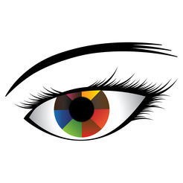
Computer Vision
Face detection, Color detection, Image recognition
Using OpenCV and Python

Slide 22

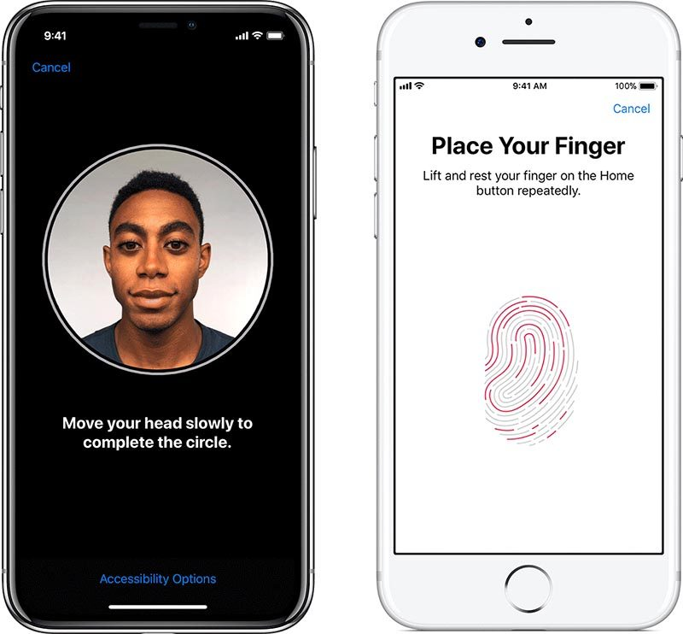
Example: Face ID on iPhone X

Slide 23

Game Development
Create a video game using the module Pygame
Use Python to write the logic of the game
Apps can run on Android devices

Slide 24
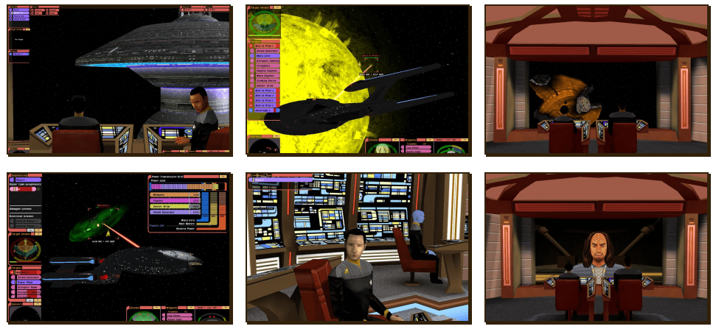
Star Trek: Bridge Commander

Slide 25
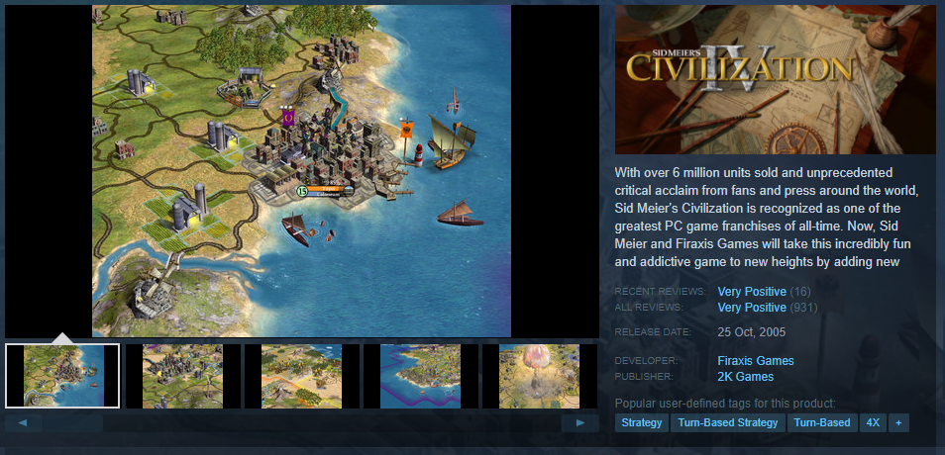
Civilization IV

Slide 26
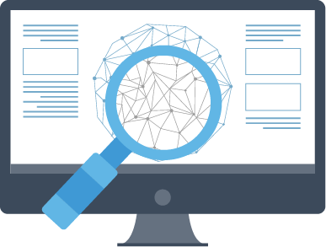
Web Scraping
Grab some data from a website that doesn’t allow convenient export

Slide 27
Example: Business uses
Gathering email addresses
Product review scraps
Scraping data from other websites
e.g.
Scraping of funny video titles with more than 1 million views. To analyze what kind of titles are doing well.
Scraping Amazon for specific category of books.

Slide 28
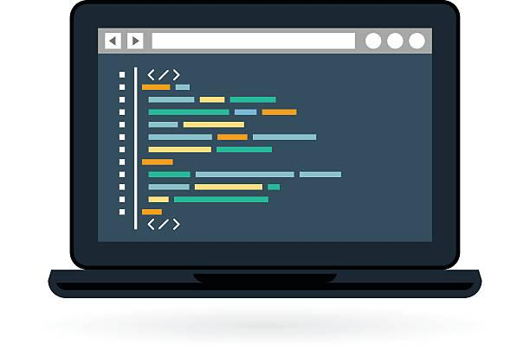
Writing Scripts
Just as in any other language

Slide 29
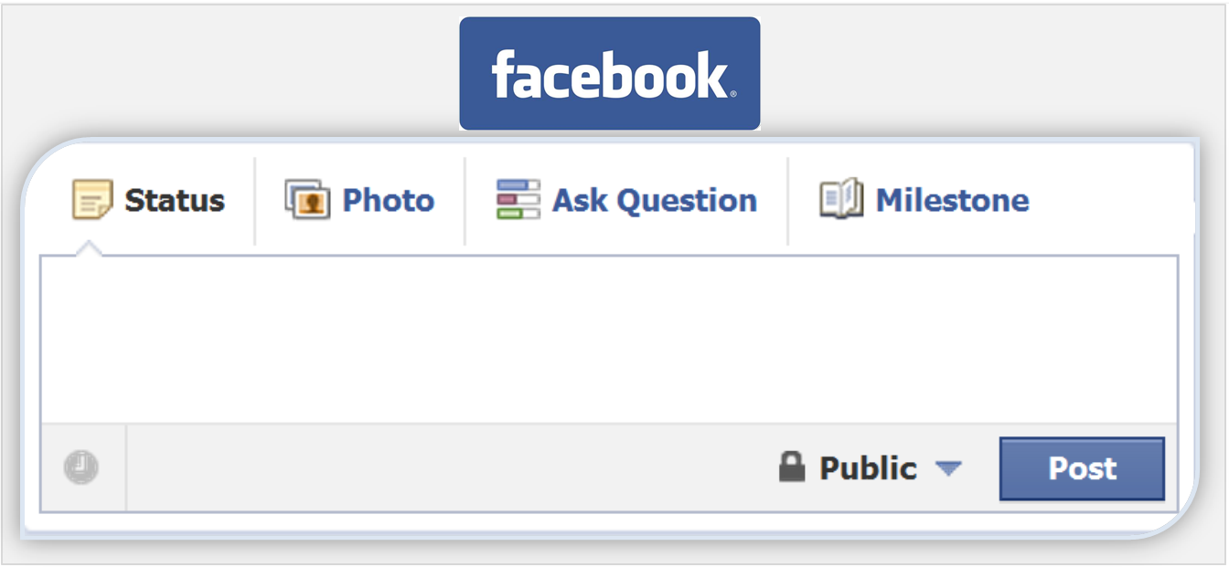
Browser Automation
Browser Automation
Use Selenium with Python

Slide 30
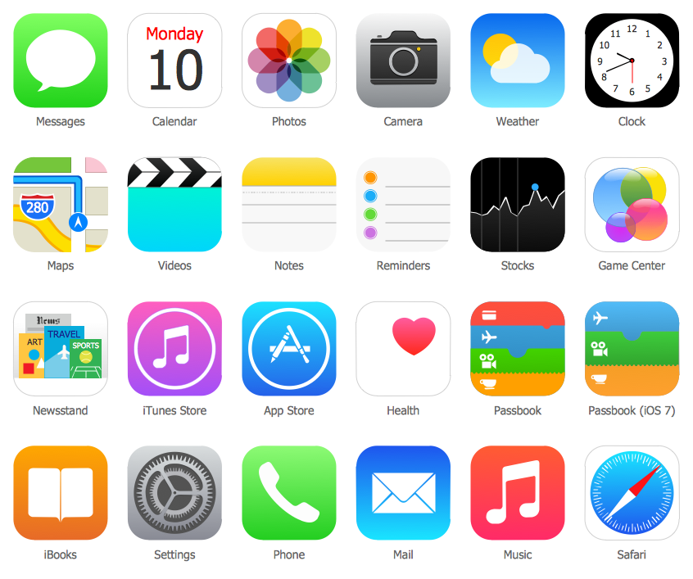
GUI Development
Create a Desktop application
Use modules Tkinter and PyQt to support it

Slide 31
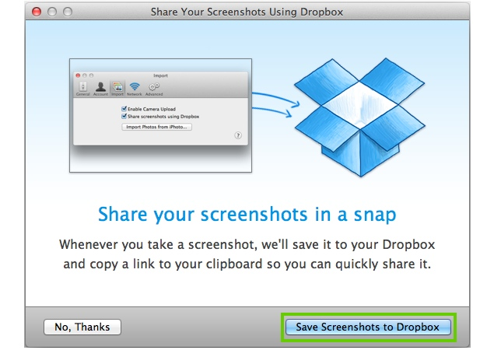


Slide 32
Thank you!

